Slide 1

Classes and Methods
Classes and Methods Problems

Slide 2
Problem 1
Design a class to represent a credit card. Think about the attributes of a credit card; that is, what data is on the card? What behaviors might be reasonable for a credit card? Use the answers to these questions to write a UML class diagram for a credit card class. Then give three examples of instances of this class.

Slide 3
Problem 2
Consider a class that keeps track of the sales of an item. An object of this class will have the attributes • Number sold • Total sales • Total discounts • Cost per item • Bulk quantity • Bulk discount percentage and the following methods: • registerSale(n) records the sale of n items. If n is larger than the bulk quantity, the cost per item will be reduced by the bulk discount. • displaySales displays the number sold, the total sales, and total discount.

Slide 4
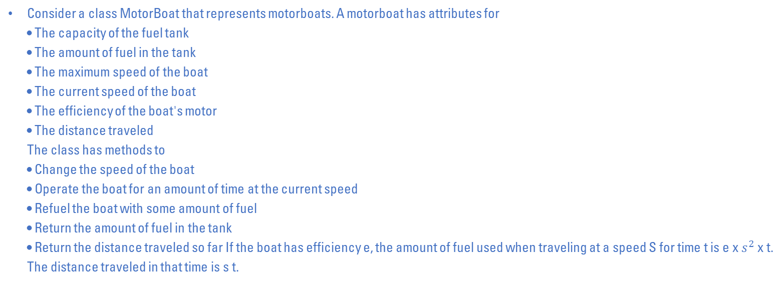
Problem 3
Consider a class MotorBoat that represents motorboats. A motorboat has attributes for • The capacity of the fuel tank • The amount of fuel in the tank • The maximum speed of the boat • The current speed of the boat • The efficiency of the boat's motor • The distance traveled The class has methods to • Change the speed of the boat • Operate the boat for an amount of time at the current speed • Refuel the boat with some amount of fuel • Return the amount of fuel in the tank • Return the distance traveled so far If the boat has efficiency e, the amount of fuel used when traveling at a speed S for time t is e x $s^{2}$ x t. The distance traveled in that time is s t.

Slide 5
Problem 4
Consider a class PersonAddress that represents an entry in an address book. Its attributes are • The first name of the person • The last name of the person • The e-mail address of the person • The telephone number of the person It will have methods to • Access each attribute • Change the e-mail address • Change the telephone number • Test whether two instances are equal based solely on name

Slide 6
Problem 5
Consider a class RatingScore that represents a numeric rating for something such as a movie. Its attributes are • A description of what is being rated • The maximum possible rating • The rating It will have methods to • Get the rating from a user • Return the maximum rating possible • Return the rating • Return a string showing the rating in a format suitable for display

Slide 7
Problem 6
Write a grading program for an instructor whose course has the following policies: • Two quizzes, each graded based on 10 points, are given. • One midterm exam and one final exam, each graded based on 100 points, are given. • The final exam counts for 50 percent of the grade, the midterm counts for 25 percent, and the two quizzes together count for a total of 25 percent. (Do not forget to normalize the quiz scores. They should be converted to percentages before they are averaged in.) Any grade of 90 percent or more is an A, any grade between 80 and 89 percent is a B, any grade between 70 and 79 percent is a C, any grade between 60 and 69 percent is a D, and any grade below 60 percent is an F. The program should read in the student's scores and display the student's record, which consists of two quiz scores, two exam scores, the student's total score for the entire course, and the final letter grade. The total score is a number in the range 0 to 100, which represents the weighted average of the student's work

Slide 8
Problem 7
Create a class that represents a grade distribution for a given course. Write methods to perform the following tasks: • Set the number of each of the letter grades A, B, C, D, and F. • Read the number of each of the letter grades A, B, C, D, and F. • Return the total number of grades. • Return the percentage of each letter grade as a whole number between 0 and 100, inclusive. • Draw a bar graph of the grade distribution. The graph will have five bars, one per grade. Each bar can be a horizontal row of asterisks, such that the number of asterisks in a row is proportionate to the percentage of grades in each category. Let one asterisk represent 2 percent, so 50 asterisks correspond to 100 percent. Mark the horizontal axis at 10 percent increments from 0 to 100 percent, and label each line with its letter grade.

Slide 9
Problem 8
Create a class Book that represents information about a. it should have attributes: • Name of the book. • ISBN of the book. • Author of the book. • Publisher of the book. Write methods to perform the following tasks: • Access the attributes. • To get the information of the book.

Slide 10
Problem 9
Create a class Date that represents a specified date. it should have attributes: • Year. • Month. • Day. Write methods to perform the following tasks: • Access the attributes. • Display the entered date in the corresponding format (31/December/2017).

Slide 11
Problem 10
Create a class Rational that represents a fraction number. it should have attributes: • a which represents numerator of the fraction number. • b which represents denominator of the fraction number. Write methods to perform the following tasks: • Add which returns addition of two fractions. • Subtract which returns subtraction of two fractions. • Multiply which returns multiplication of two fractions. • Divide which returns division of two fractions. • gcd which returns the greatest common divisor between a and b.

